Slide 1
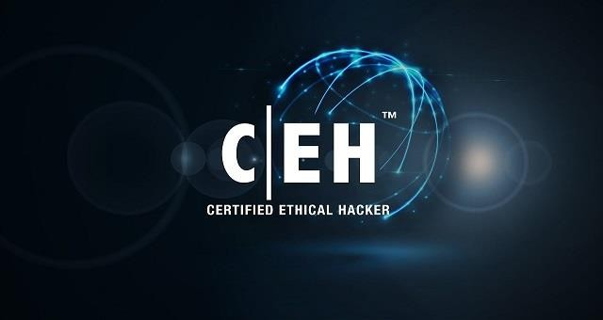

CEH: Understanding Ethical Hacking
Eng.\ Mohamed Magdy Ali
Cyber Security Specialist

Slide 2
Agenda
What is Hacking?
Who is a Hacker?
What is Ethical Hacking?
Why Ethical Hacking is Necessary?
Why should I care?
The Phases of Ethical Hacking
Network vs Web Browser Attacks
Who is Responsible for my Data in the Cloud
Vulnerability Assessments & Penetration Testing
What is in the Course

Slide 3
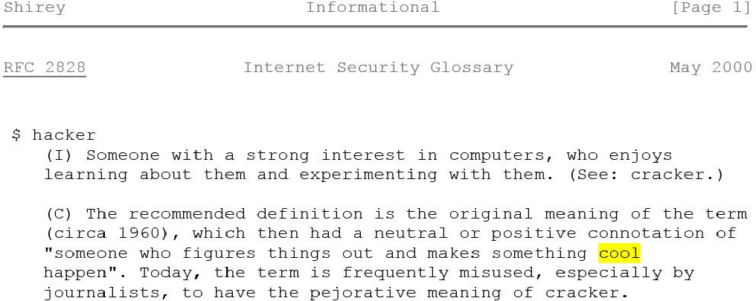
Think Like a Hacker

Slide 4
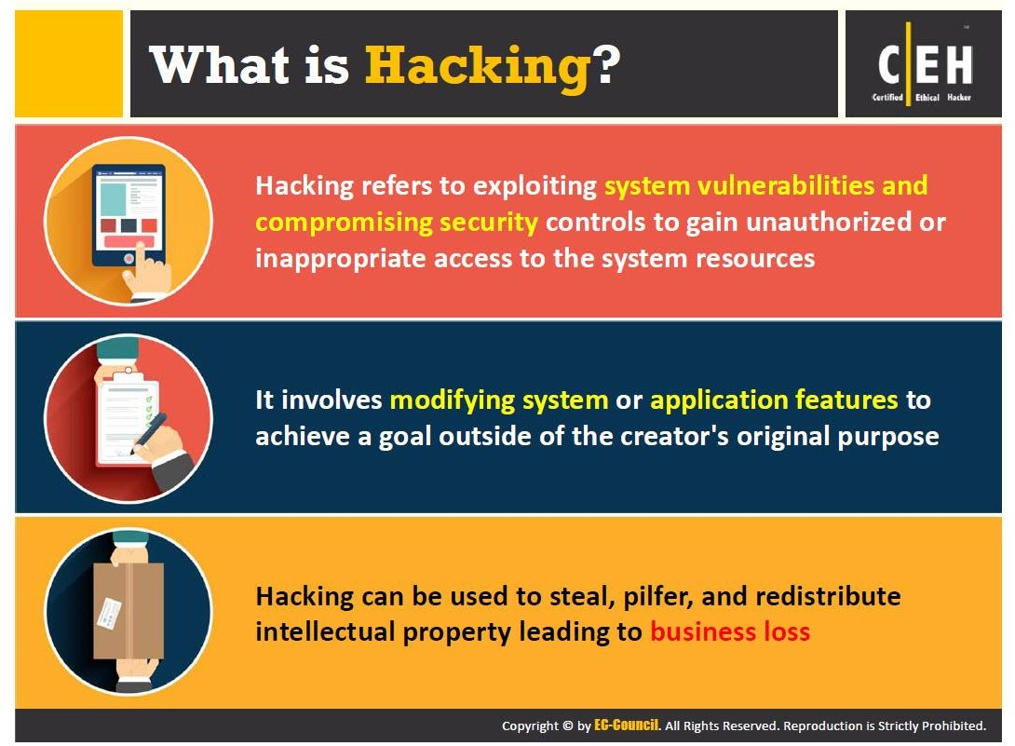
What is Hacking?

Slide 5
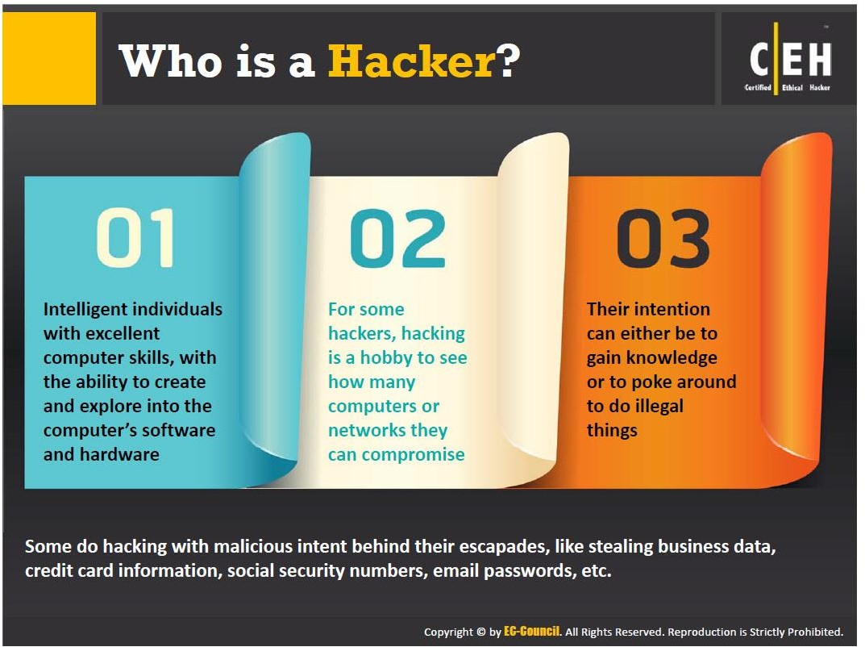
Who is a Hacker?

Slide 6
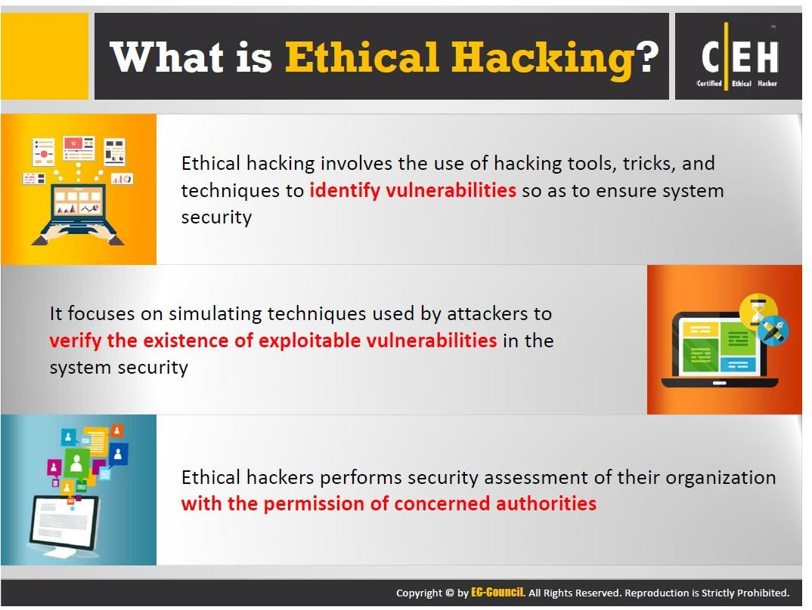
What is Ethical Hacking?

Slide 7
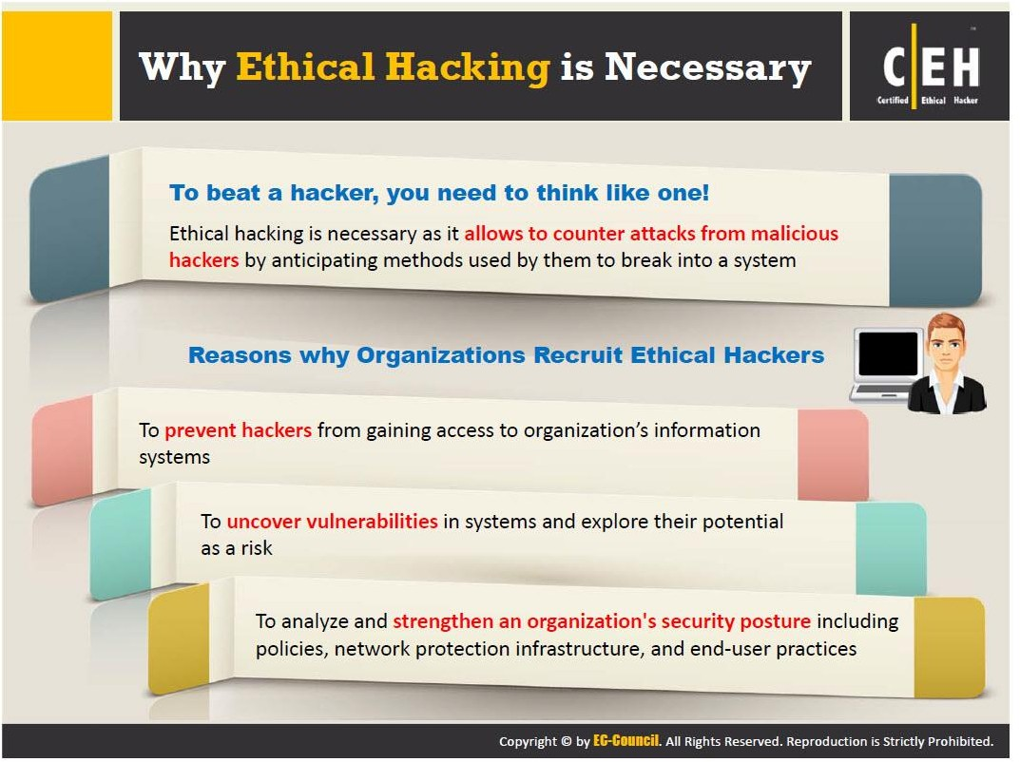
Why Ethical Hacking is Necessary?

Slide 8
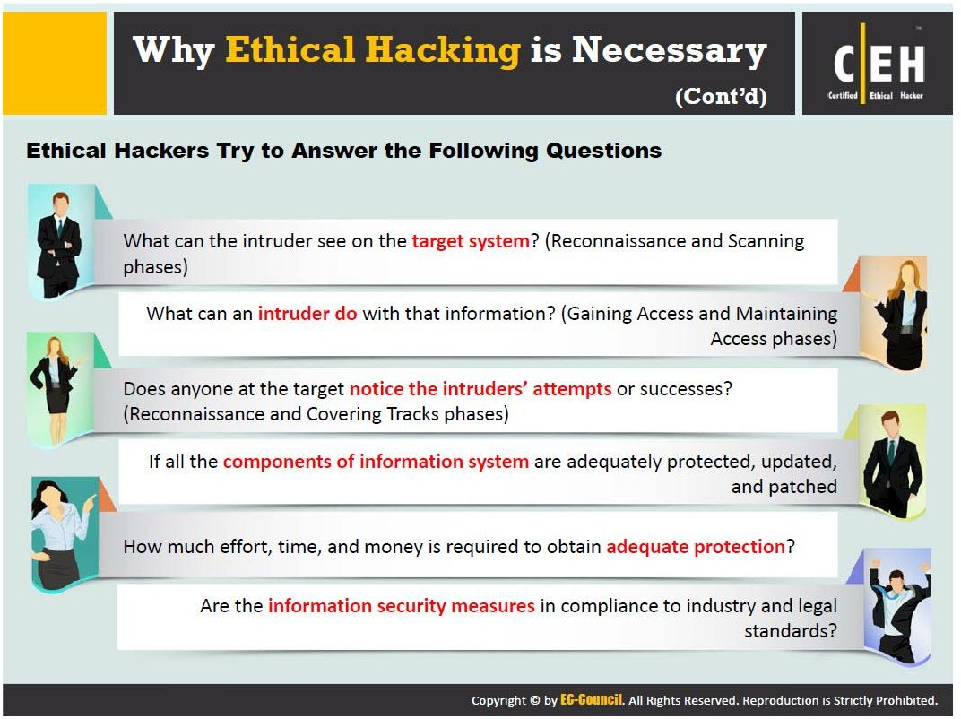
Why Ethical Hacking is Necessary?

Slide 9

Why Should I Care

Slide 10
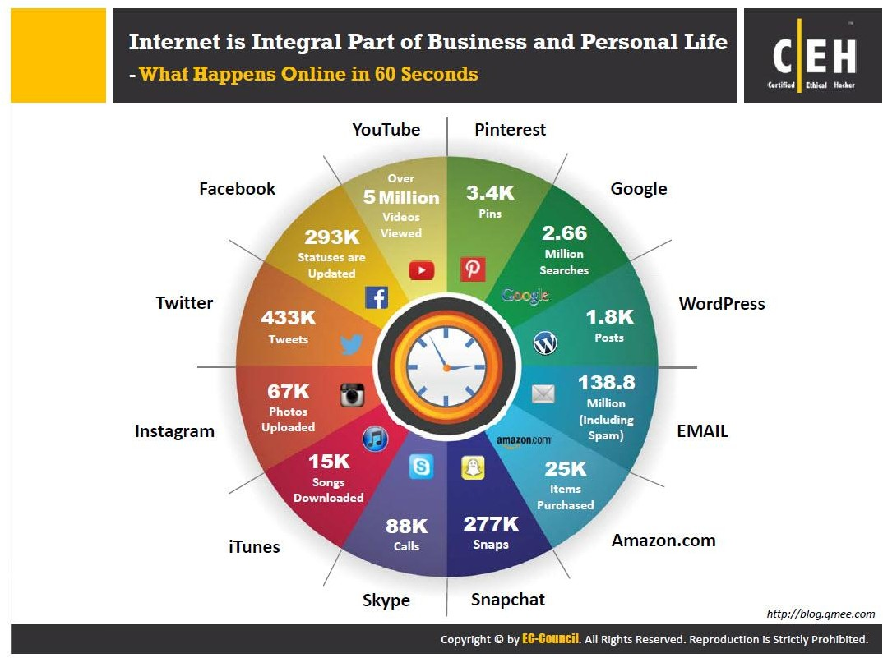

Slide 11
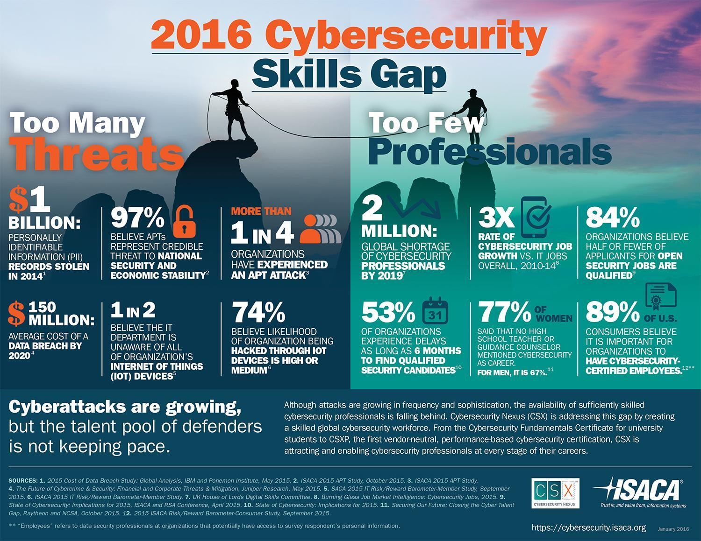

Slide 12
The Phases of Ethical Hacking

Slide 13
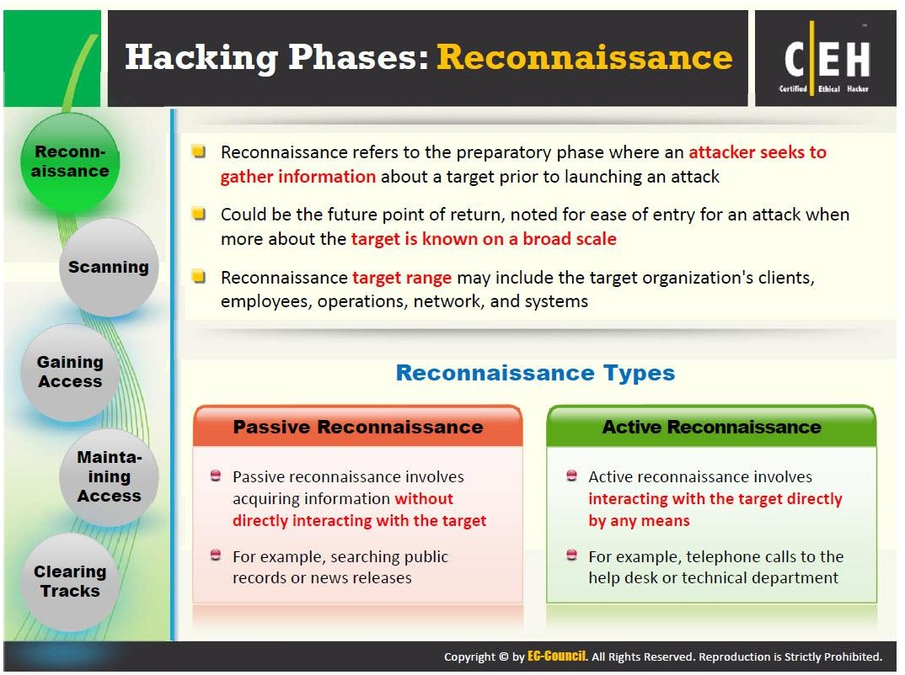
Reconnaissance

Slide 14
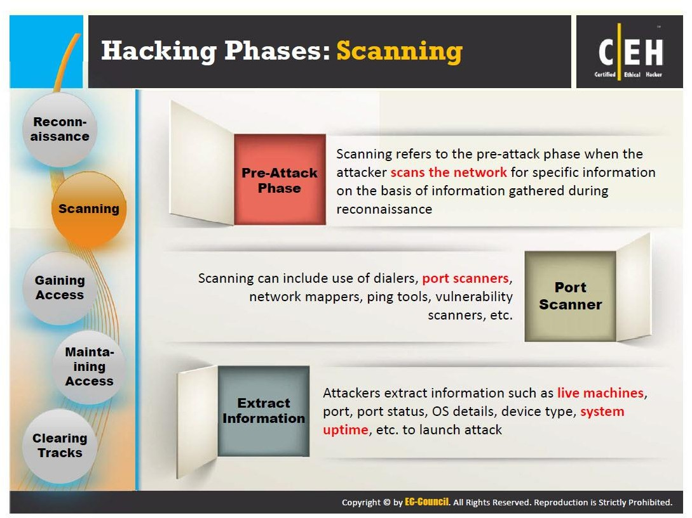
Scanning

Slide 15
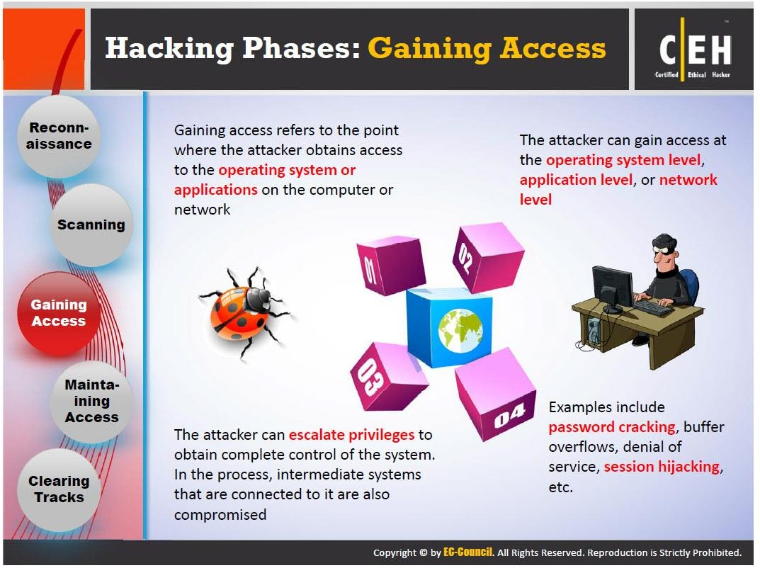
Gaining Access

Slide 16
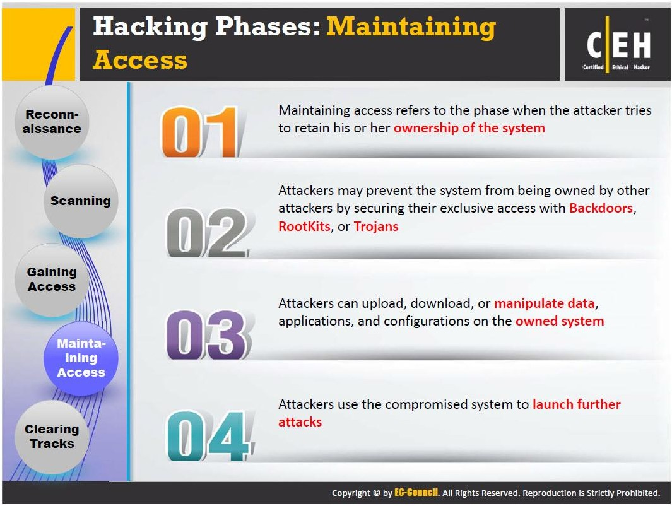
Maintaining Access

Slide 17
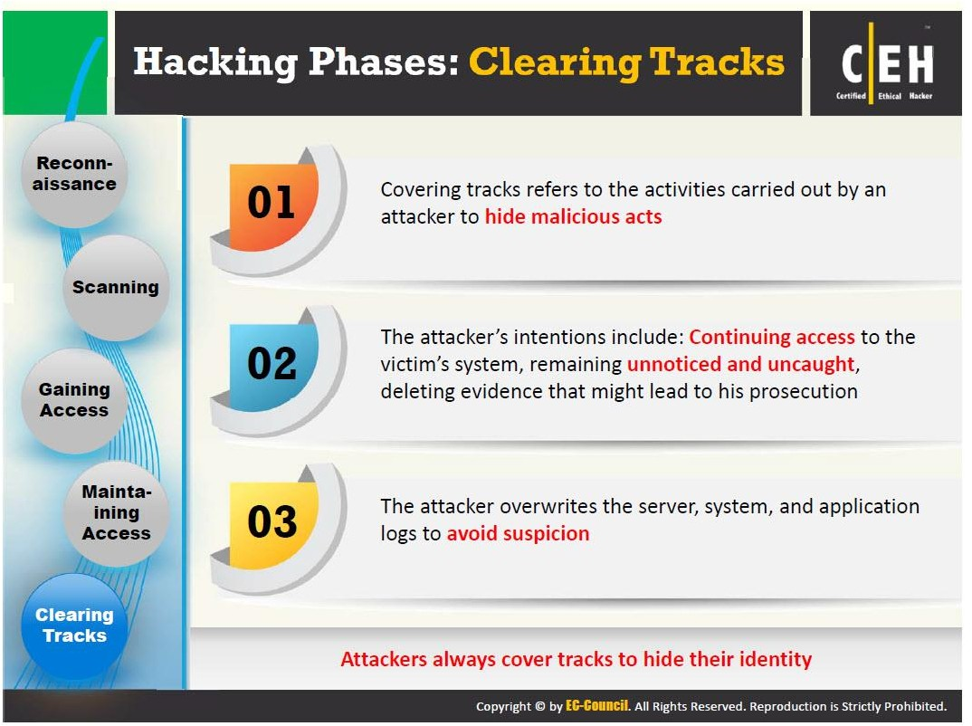
Clearing Tracks

Slide 18
Network vs Web Browser Attacks

Slide 19
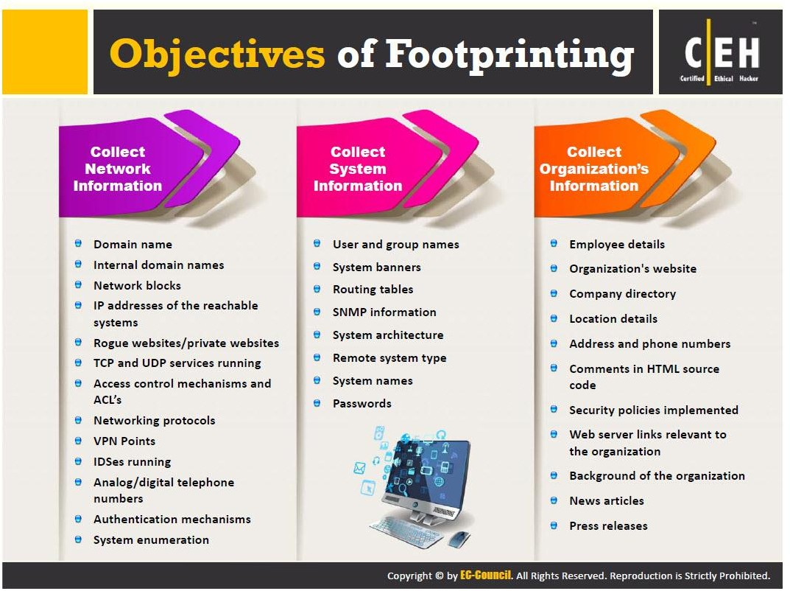
Objectives of Footprinting

Slide 20
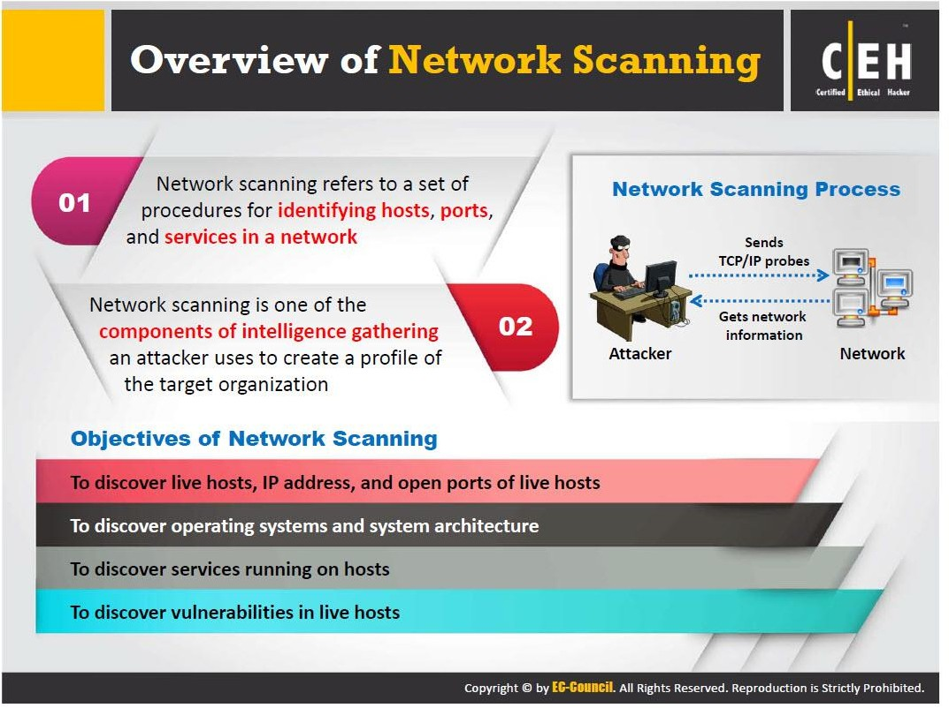
Overview of Network Scanning

Slide 21
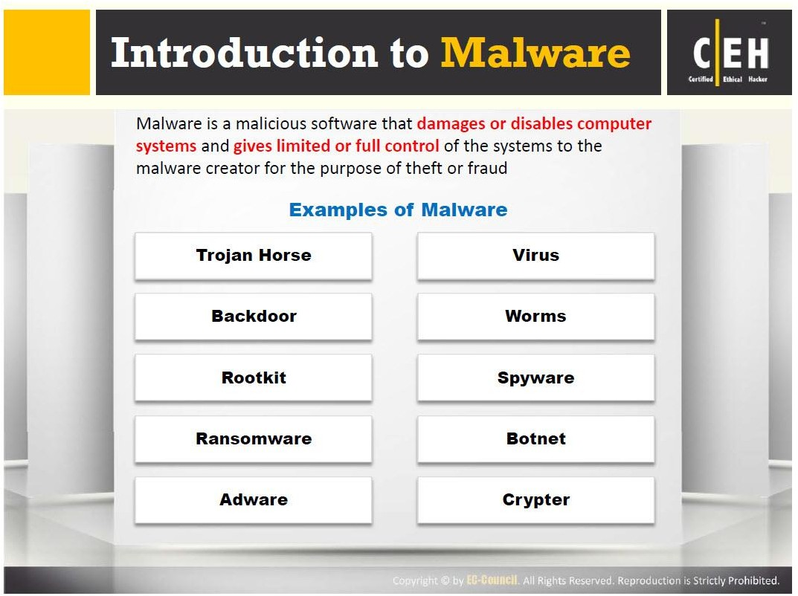
Introduction to Malware

Slide 22
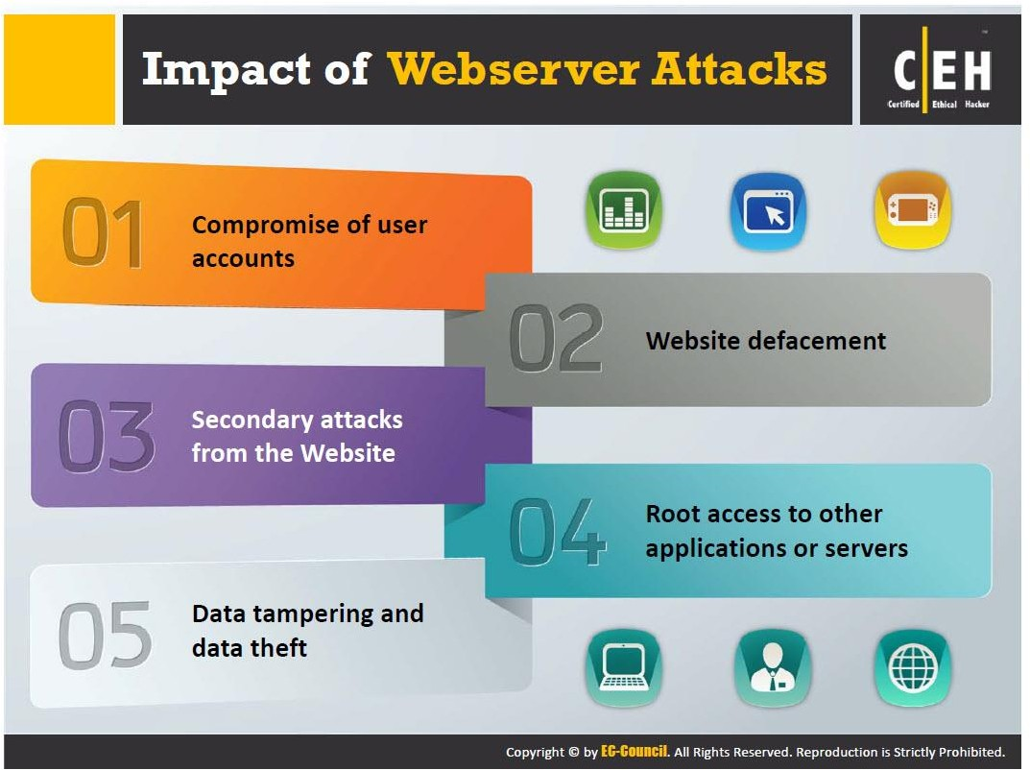
Impact of Webserver Attacks

Slide 23
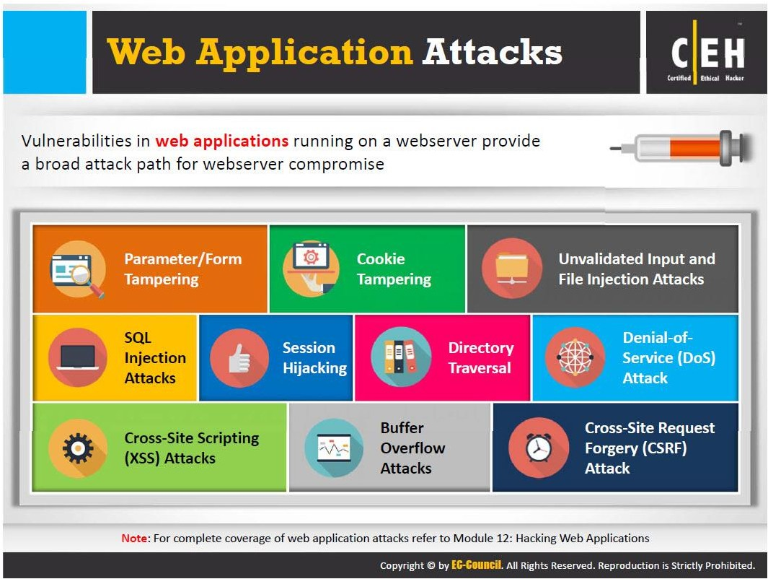
Web Application Attacks

Slide 24
Who is Responsible for my Data in the Cloud

Slide 25
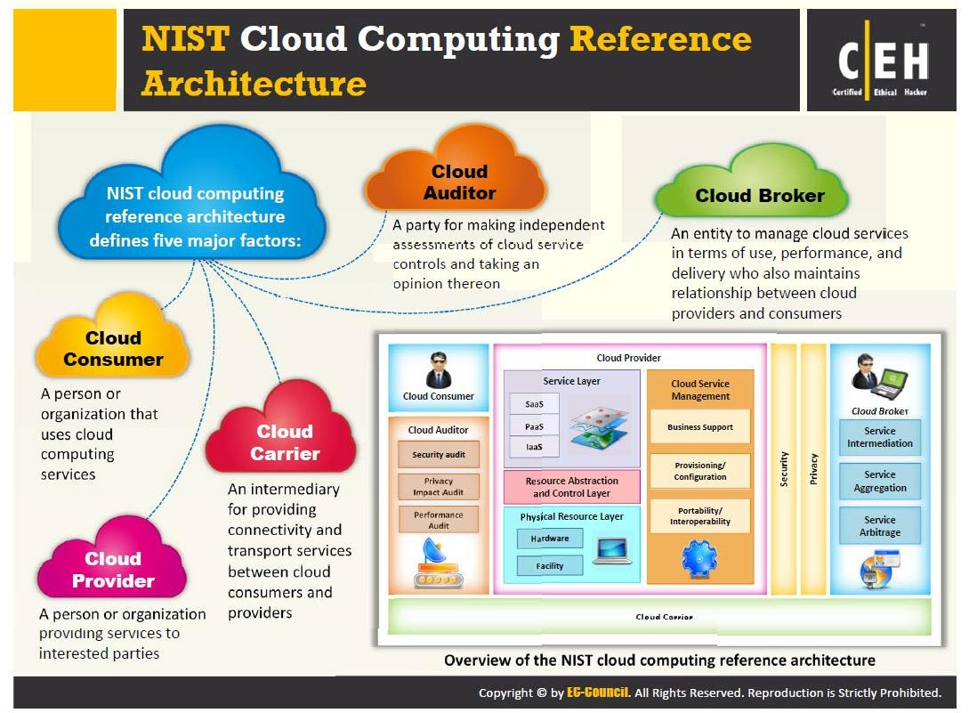
NIST Cloud Computing Reference Architecture

Slide 26
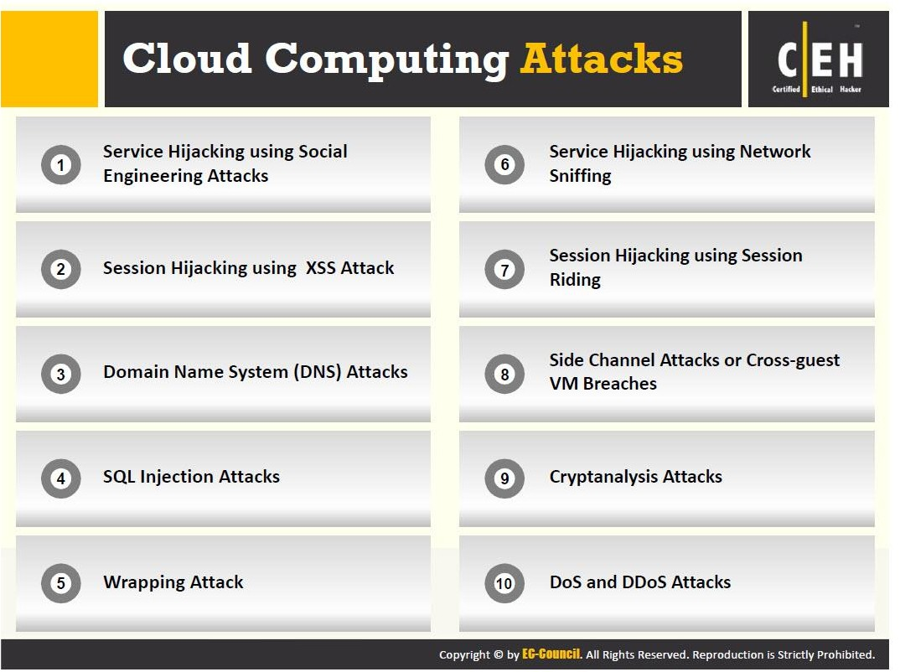
Cloud Computing Attacks

Slide 27
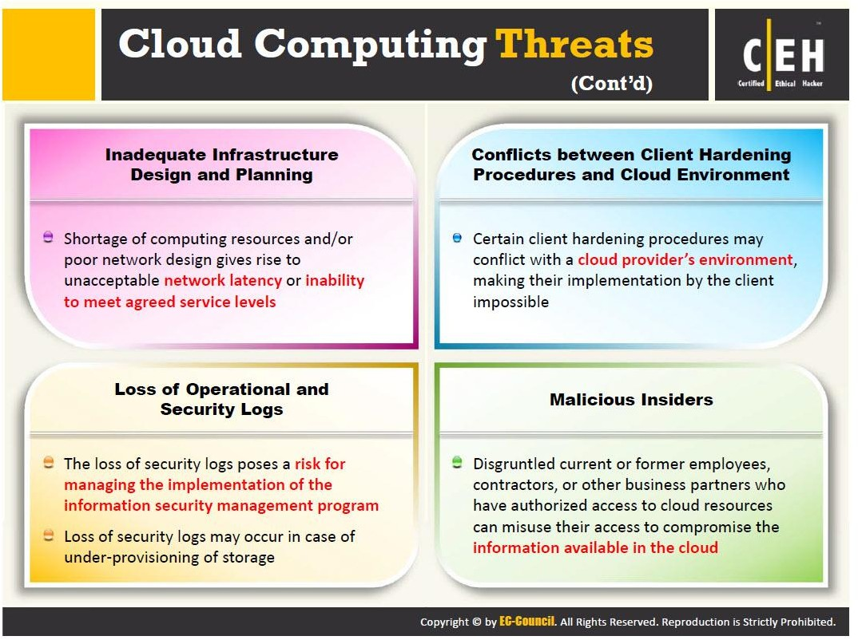
Cloud Computing Threats

Slide 28
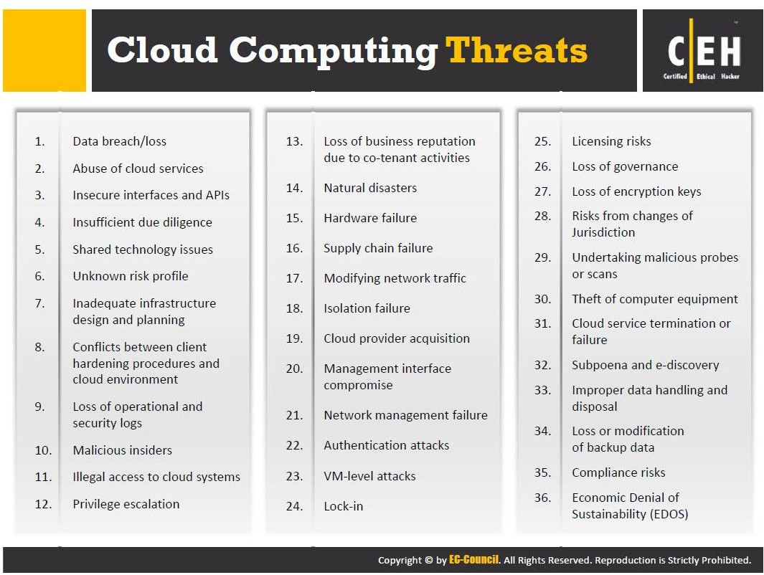
Cloud Computing Threats

Slide 29
Vulnerability Assessments & Penetration Testing

Slide 30


Slide 31


Slide 32
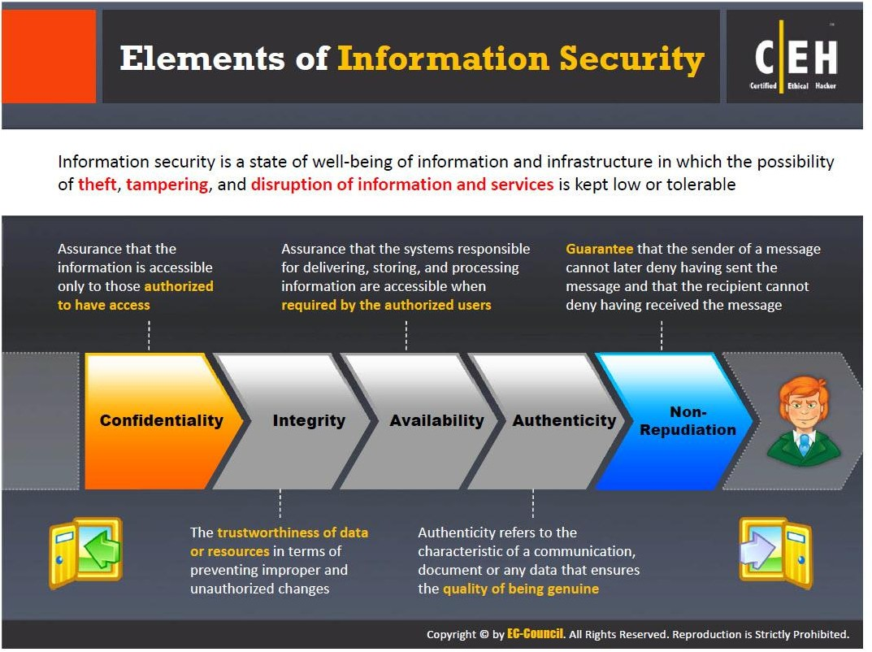
Elements of Information Security

Slide 33
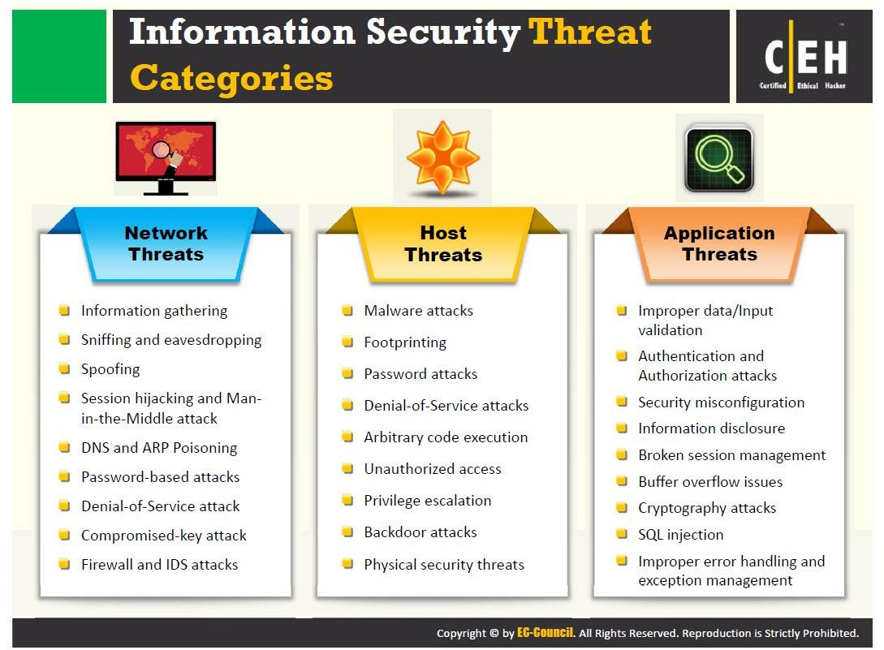
Information Security Threat Categories

Slide 34
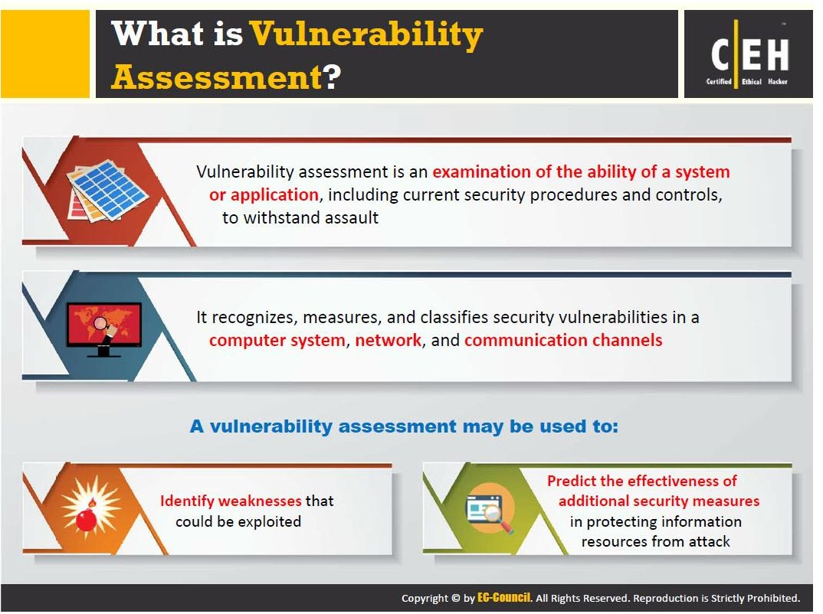
What is Vulnerability Assessment?

Slide 35
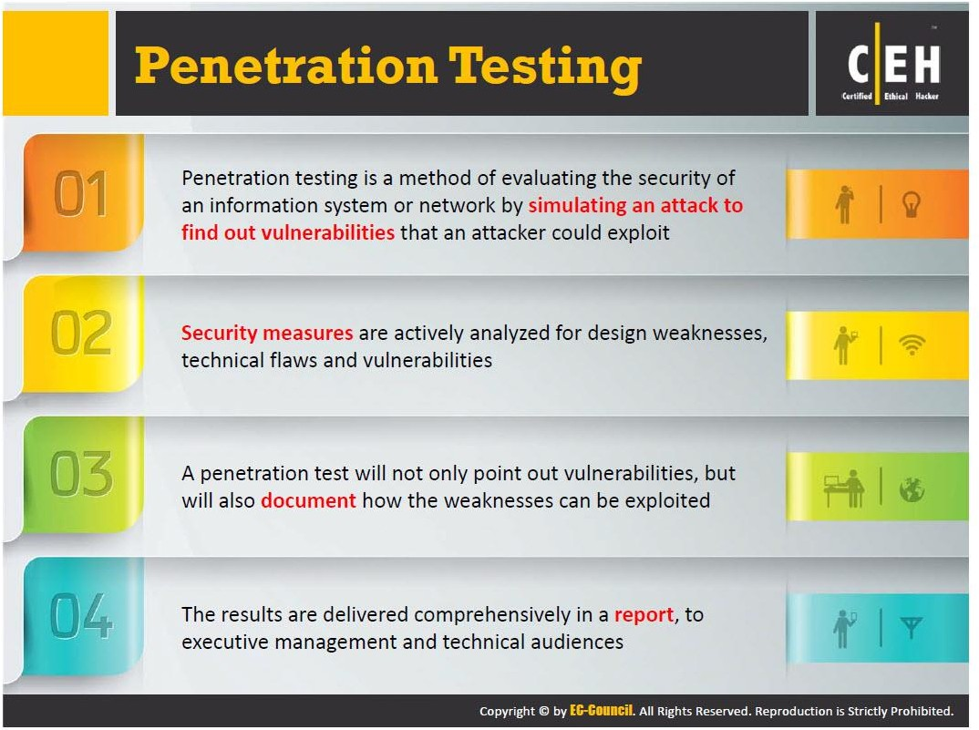
Penetration Testing

Slide 36
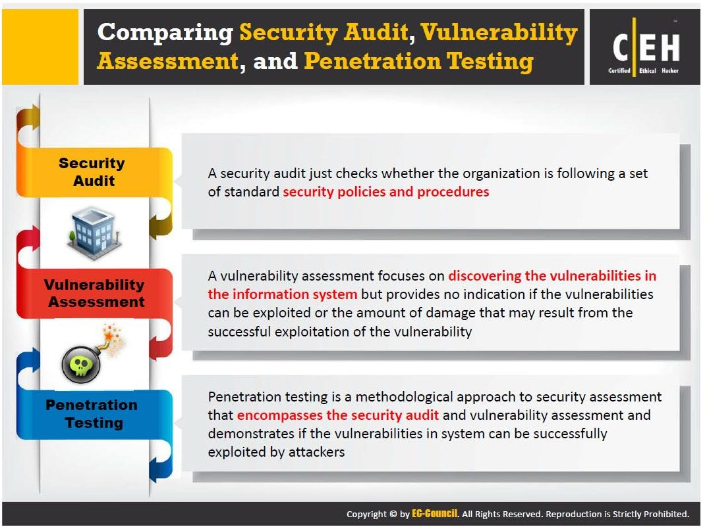
Security Audit vs Vulnerability Assessment vs Penetration Testing

Slide 37
What is in the Course

Slide 38
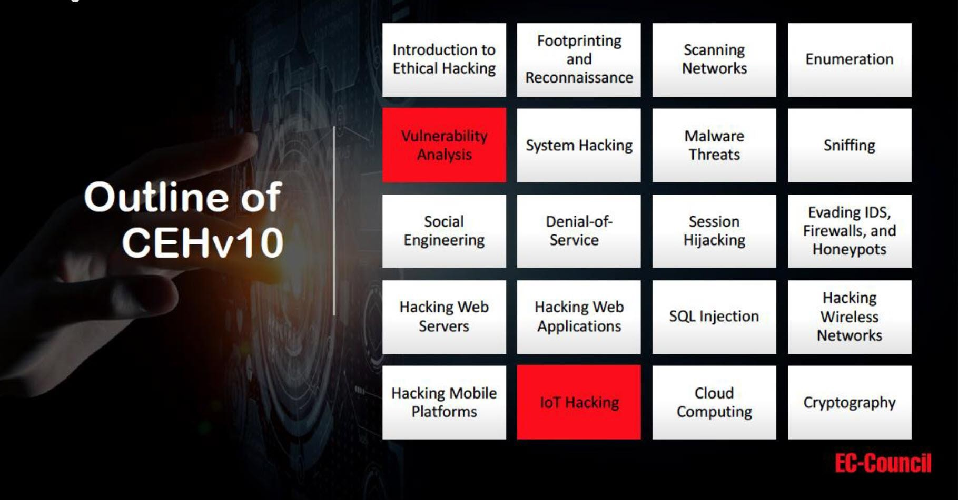
Outline

Slide 39
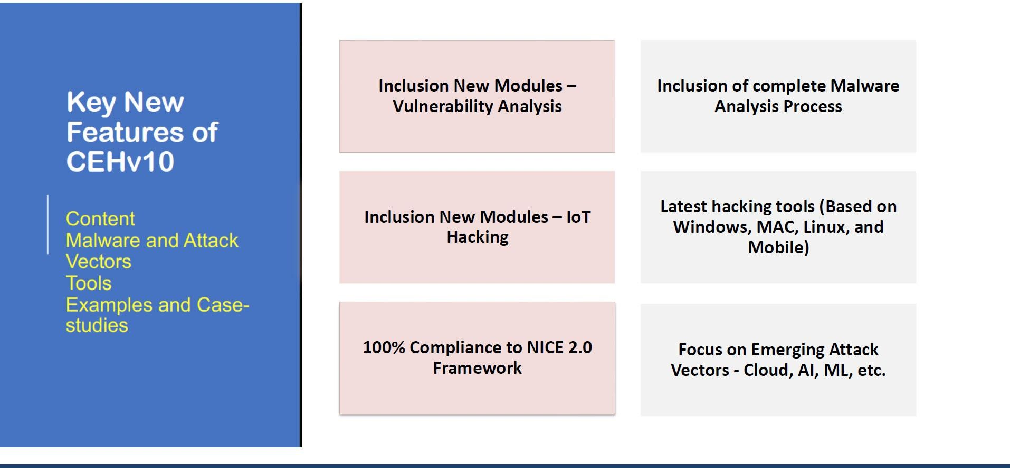
New Features

Slide 40
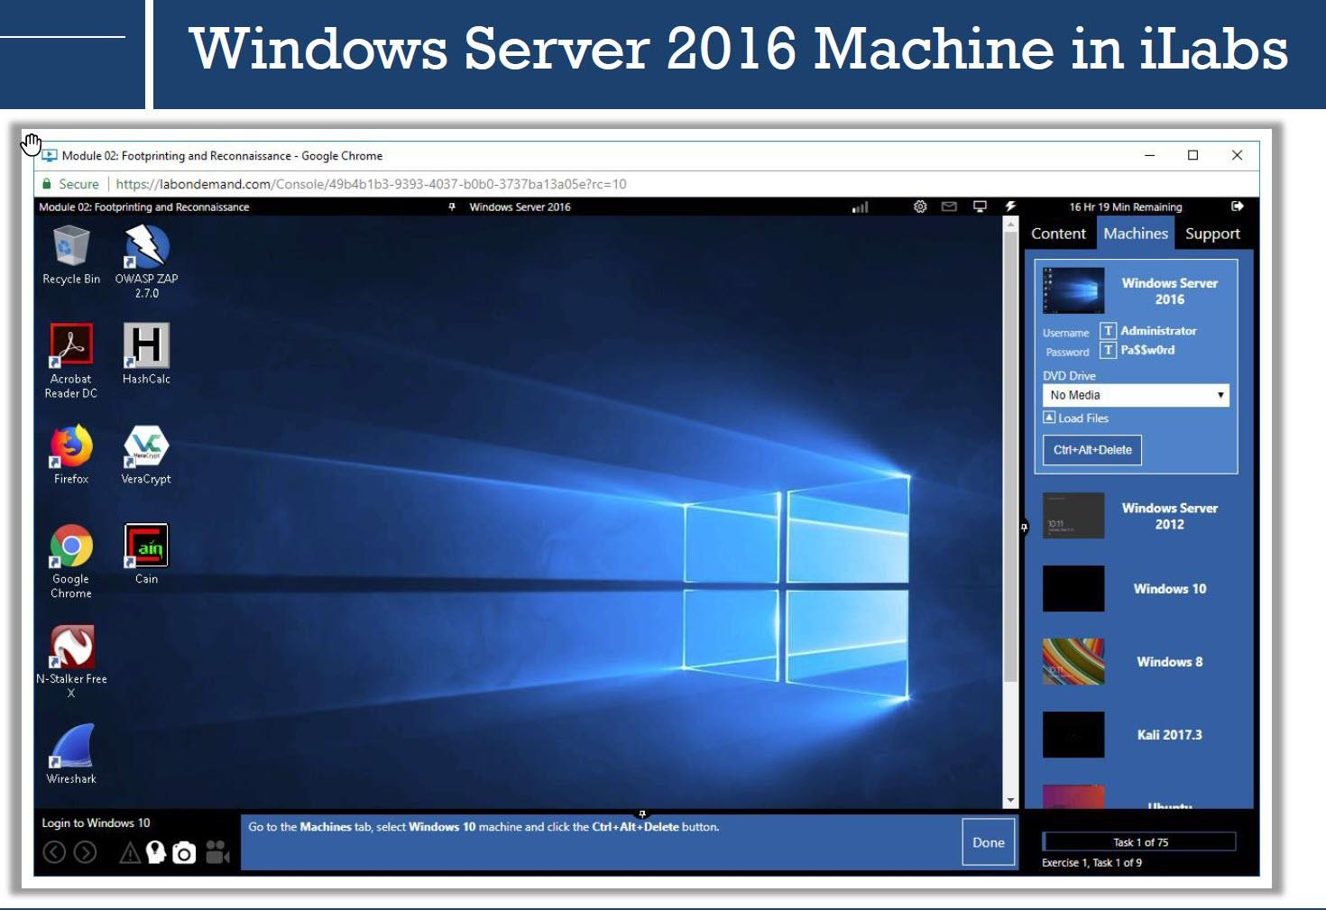
CEH v10 iLabs

Slide 41
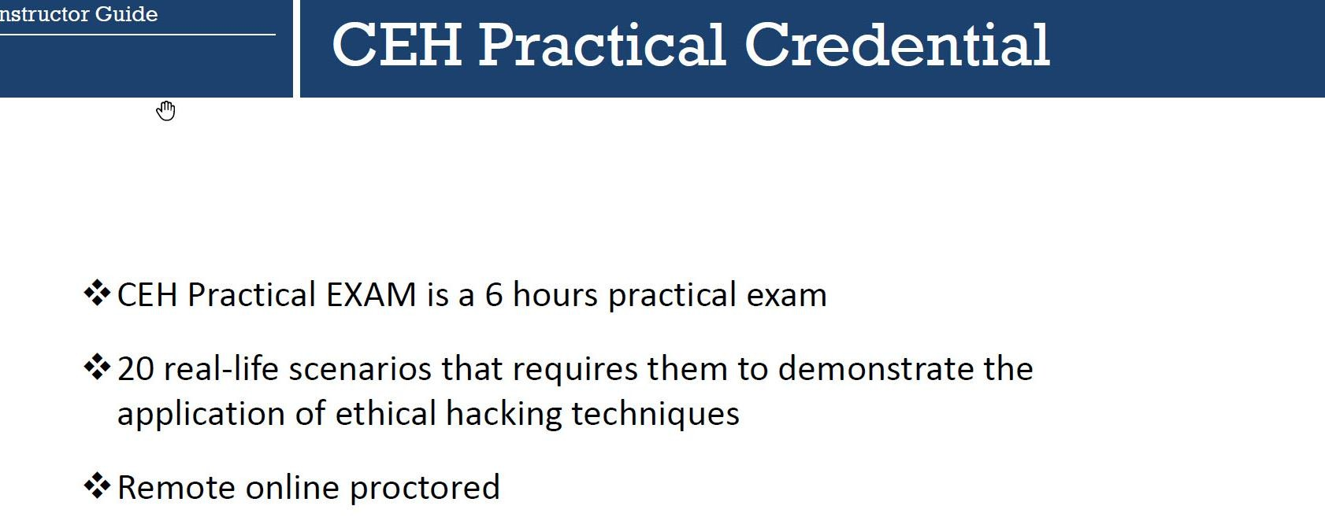
Practical

Slide 42
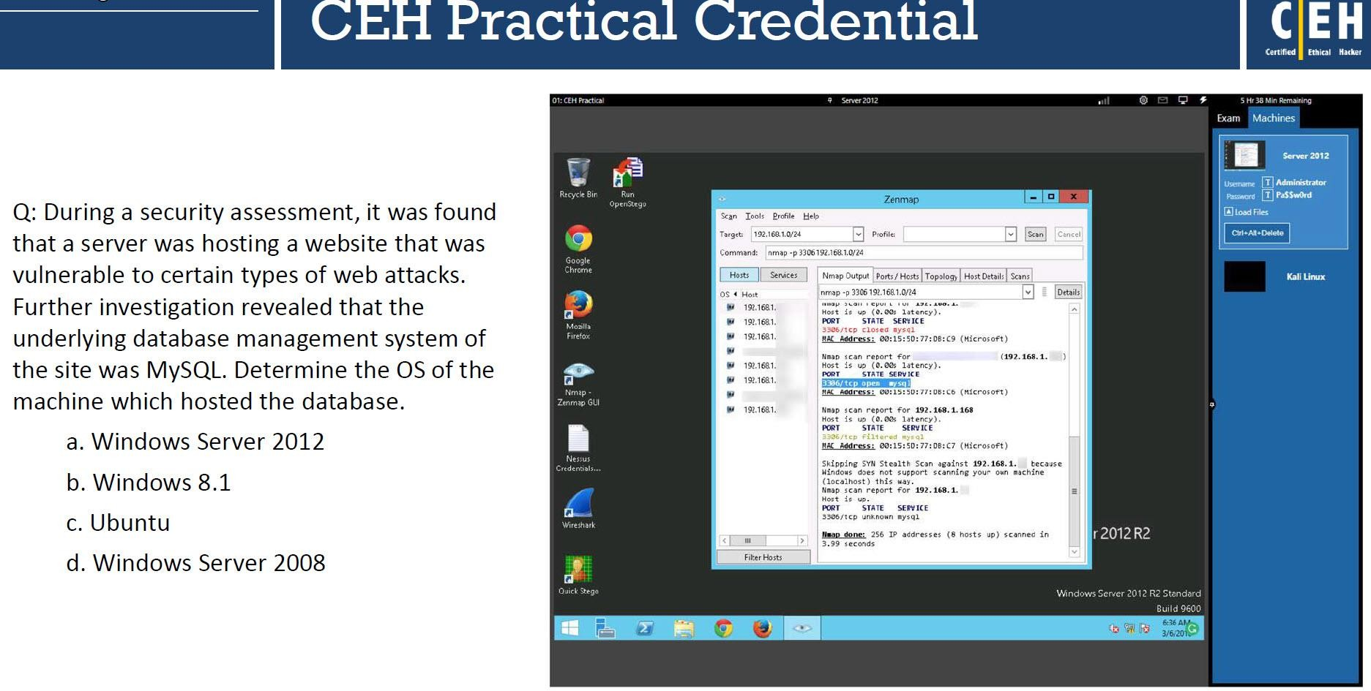
Practical

Slide 43

THANK YOU !!!

